Slide 1

DIGITAL ELECTRONICS
III Semester CSE, CSE (AIML) & CSE (DS)
Dr. Ajit Kumar Patro
DEPARTMENT OF ELECTRONICS AND COMMUNICATION ENGINEERING
SCHOOL OF ENGINEERING & TECHNOLOGY
GIET UNIVERSITY, GUNUPUR, ODISHA

Slide 2
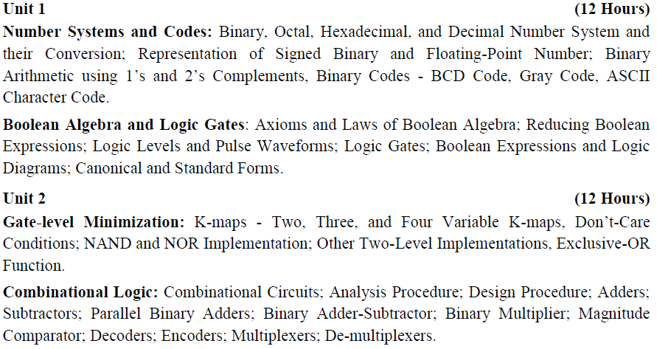
Syllabus

Slide 3
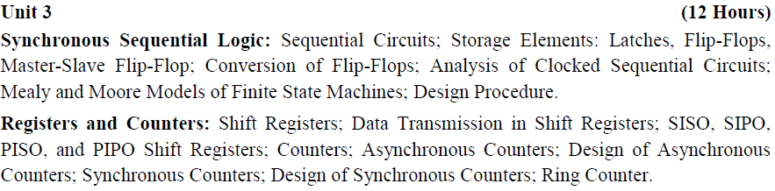
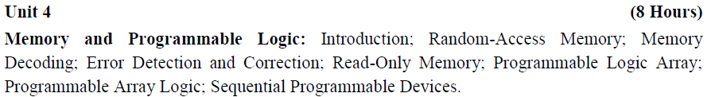

Slide 4
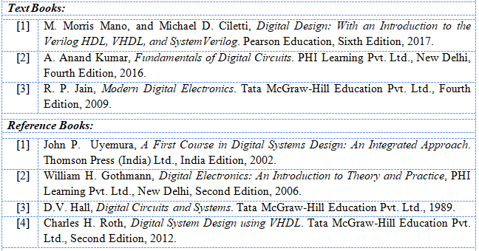
Books

Slide 5

What is Digital Electronics?
Digital electronics is the branch of electronics which is based on the combination and switching of voltages called logic levels.

Slide 6
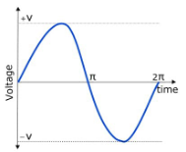
Electronics circuits and systems are of two kinds - analog and digital.
What is Analog circuits ?
Analog circuits are those in which voltages and currents vary continuously through the given range. They can take infinite values within the specified range.
For example, the output voltage from an audio amplifier might be any one of the infinite values between -10 V and +10 V at any particular instant of time.

Slide 7
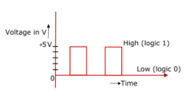
What is Digital Circuit?
A digital circuit is one in which the voltage levels assume a finite number of distinct values. There are just discrete voltage levels. However, each voltage level in a particle digital system can be a narrow band or range of voltages.

Slide 8
Digital circuits are often called switching circuits because the voltage levels in a digital circuit are assumed to be switched from one value to another instantaneously, i.e. the transition time is assumed to be zero.
Digital circuits are also called logic circuits because each type of digital circuit obeys a certain set of logic rules. The manner in which a logic circuit responds to input is referred to as the circuit's logic.

Slide 9
Advantages of Digital Systems
Digital systems are easier to design.
Information storage is easy.
Accuracy and precision are greater.
Digital systems are more versatile.
Digital circuits are less affected by noise.
More digital circuitry can be fabricated on IC chips.

Slide 10
UNIT-1
Chapter-1
Number Systems and Codes
Binary, Octal, Hexadecimal, and Decimal Number System and their Conversion

Slide 11
What is number System?
A number system is defined as the technique of writing to express numbers.
The number system has different bases and the most common of them are the decimal, binary, octal, and hexadecimal.
The base or radix of the number system is the total number of the digit used in the number system.

Slide 12
What is the need of Number System?
Computers understand machine language. Every letter, symbol etc. that we write in the instructions given to computer, it gets converted into machine language.
This machine language comprises of numbers. In order to understand the language used by computers and other digital system it is crucial to have a better understanding of number system.

Slide 13
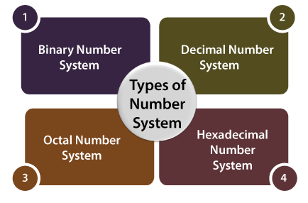
Types of Number System
There are various types of number systems used for representing information.
The number systems are of following types.
1. Binary Number System
2. Decimal Number System
3. Octal Number System
4. Hexadecimal Number System

Slide 14
1. Binary Number System
Generally, a binary number system is used in the digital computers.
In this number system, it carries only two digits, either 0 or 1. So the base or radix of the number system is 2.
There are two types of electronic pulses present in a binary number system. The first one is the absence of an electronic pulse representing '0'and second one is the presence of electronic pulse representing '1'.
Each digit is known as a bit.
A four-bit collection (1101) is known as a nibble.
A collection of eight bits (11001010) is known as a byte.

Slide 15
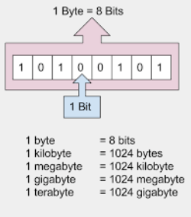
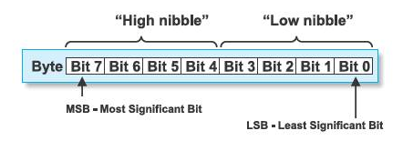

Slide 16

Examples
a) (10101)₂
b) (11011.1101)₂
c) (11001.11)₂
d) (0.101)₂
e) (110.1)₂

Slide 17
2. Decimal Number System
The decimal numbers are used in our day to day life.
The decimal number system contains ten digits and these digits are 0, 1, 2, 3, 4, 5, 6, 7, 8 & 9.
The base or radix of the number system is 10 because total 10 digits are available in the number system.
Examples:
a) (2546)₁₀ b) (36.46)₁₀ c) (4.567)₁₀ d) (984.76)₁₀

Slide 18
3. Octal Number System
The octal number system is a number system which uses eight digits to express any number.
The digits used are 0, 1, 2, 3, 4, 5, 6 & 7.
The base of the octal number system or radix is 8. This is because the total number of digits in the number system is 8.
Examples:
a) (765)₈ b) (23.46)₈ c) (67.4)₈ d) (2.546)₈

Slide 19
4. Hexadecimal Number System
It is another technique to represent the number in the digital system called the hexadecimal number system.
The number system has a base of 16 means there are total 16 symbols(0, 1, 2, 3, 4, 5, 6, 7, 8, 9, A, B, C, D, E, F) used for representing a number.
The single-bit representation of decimal values10, 11, 12, 13, 14, and 15 are represented by A, B, C, D, E, and F.
Only 4 bits are required for representing a number in a hexadecimal number.
Examples:
a) (2C.4F)₁₆ b) (7AD.9E)₁₆ c)(81B.6F)₁₆

Slide 20
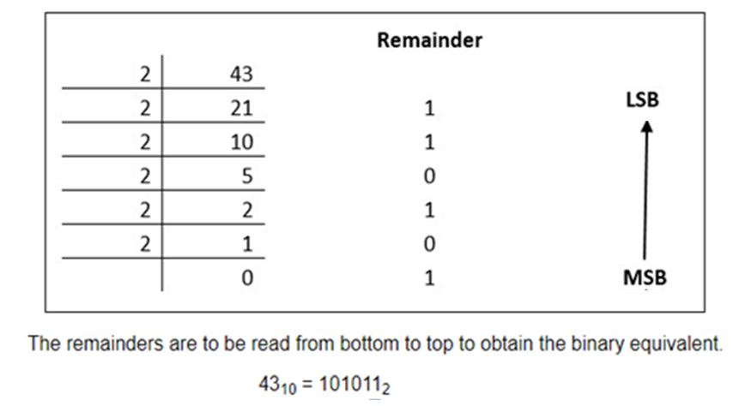
Decimal to Binary Conversion
Example: Convert the decimal number 43 in to its binary equivalent.

Slide 21
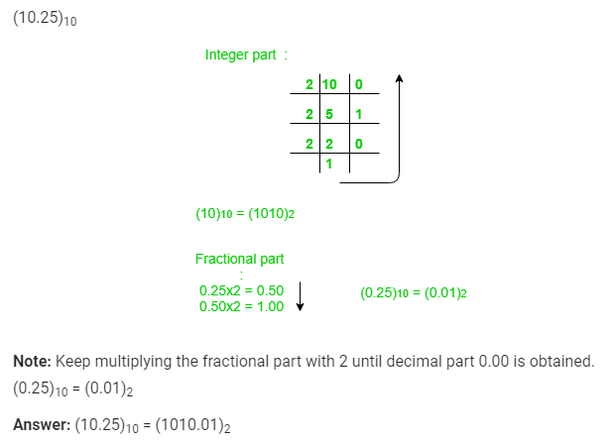
Example: Convert the decimal number 10.25 in to its binary equivalent.

Slide 22
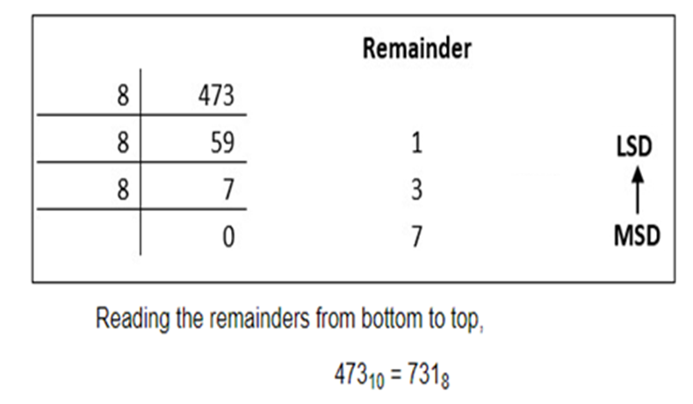
Decimal to Octal Conversion
Example: Convert the decimal number 473 in to its octal equivalent.

Slide 23
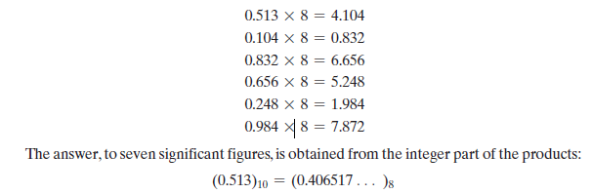
Example: Convert (0.513)₁₀ to octal.

Slide 24
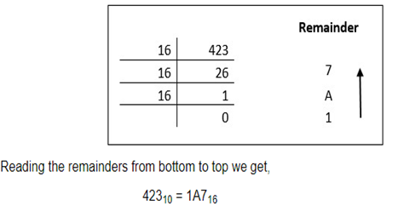
Decimal to Hexadecimal Conversion
Example: Convert the decimal number 423 in to its hexadecimal equivalent .

Slide 25
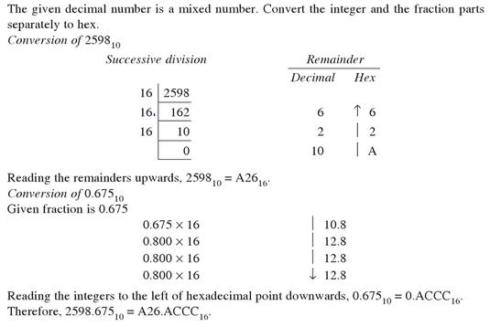
Example: Convert the (2598.675)₁₀ to hexadecimal

Slide 26

Binary to Decimal Conversion
Example: Convert the binary number 11010 in to its decimal equivalent.

Slide 27
Example: Convert the binary number 1010.01 in to its decimal equivalent.
(1010.01)₂
= 1×2³ + 0×2² + 1×2¹ + 0×2⁰ + 0×2⁻¹ + 1×2⁻²
= 8 + 0 + 2 + 0 + 0 + 0.25
= 10.25
(1010.01)₂ = (10.25)₁₀

Slide 28

Octal to Decimal Conversion
Example: Convert the octal number 726 in to its decimal equivalent.

Slide 29
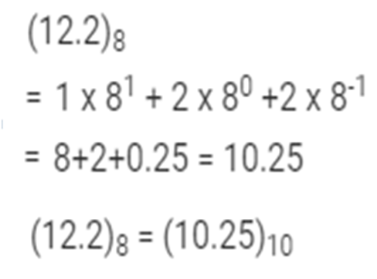
Example: Convert the octal number 12.2 in to its decimal equivalent.

Slide 30
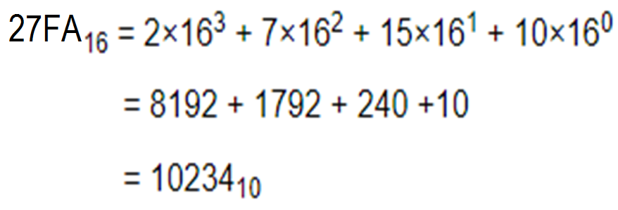
Hexadecimal to Decimal Conversion
Example: Convert the hexadecimal number 27FA in to its decimal equivalent.

Slide 31
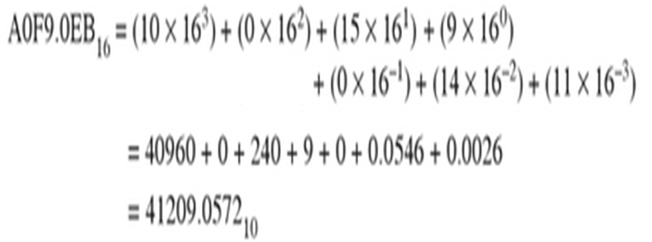
Example: Convert (A0F9.0EB)₁₆ to decimal.

Slide 32
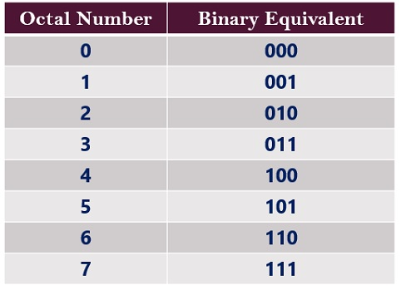
Binary to octal and vice versa

Slide 33
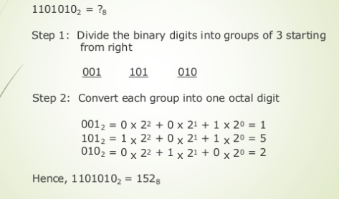
Example: Convert the binary number 1101010 in to its octal equivalent.

Slide 34
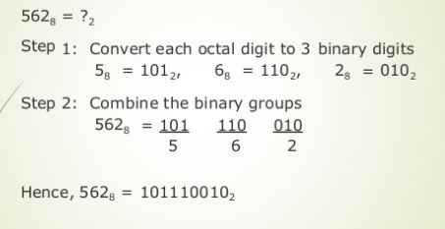
Example: Convert the octal number 562 in to its binary equivalent.

Slide 35
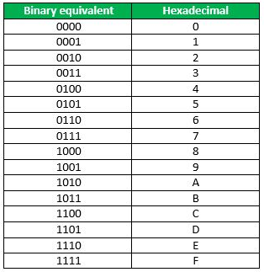
Binary to Hexadecimal and vice versa

Slide 36
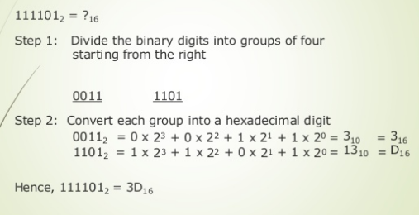
Example: Convert the binary number 111101 in to its hexadecimal equivalent.

Slide 37
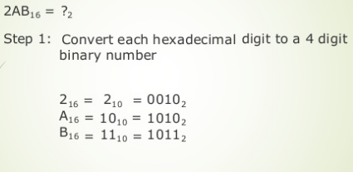
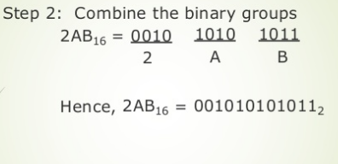
Example: Convert the hexadecimal number 2AB in to its binary equivalent.

Slide 38

Octal to Hexadecimal Conversion
To convert an octal number to hexadecimal, the simplest way is to first convert to binary and then binary to hexadecimal.
Example: Convert 756.603₈ to hexadecimal.

Slide 39

Hexadecimal to Octal Conversion
To convert a hexadecimal number to octal , the simplest way is to first convert to binary and then binary to octal.
Example: Convert B9F.AE₁₆ to octal.

Slide 40
MISCELLANEOUS EXAMPLES
Example:
Given that 16₁₀ = 100_{b}, find the value of b.
Solution
Given 16₁₀ = 100_{b}
Convert 100_{b} to decimal.
Therefore, 16 = 1 × b² + 0 × b¹ + 0 × b⁰
or 16 = b²
or b = 4

Slide 41
Example: What should be the radix of the number used in the following addition?
34 + 15 = 50
Solution
Given 34 + 15 = 50
or (34)_{r} + (15)_{r} = (50)_{r}
or 3×r¹ + 4×r⁰ + 1×r¹ + 5×r⁰ = 5×r¹ + 0×r⁰
or 3r + 4 + 1r + 5 = 5r + 0
or 4r + 9 = 5r
or 5r – 4r = 9
or r = 9

Slide 42

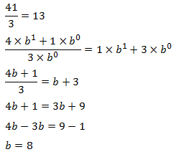
Example: Determine the possible base in the following arithmetic operation.
Solution

